Slide 1
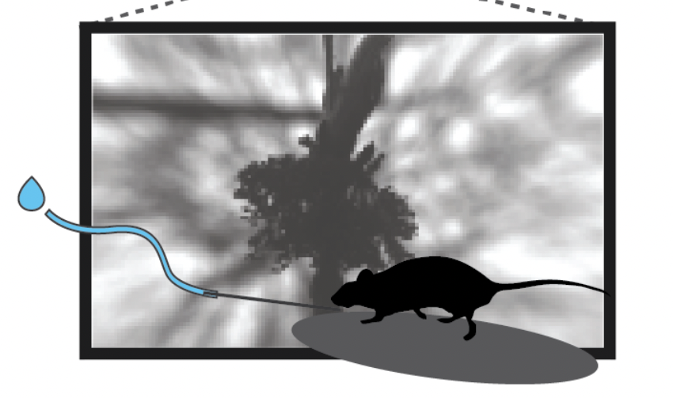

AllenNeuron: Investigating the relationship between neuronal response latencies and behavioral outputs
Pod: Abundant Ipomea Project TA: Faezeh Shafiei TA: Amirreza Bahramani
Computational neuroscience Summer School
Neuromatch Academy

Slide 2
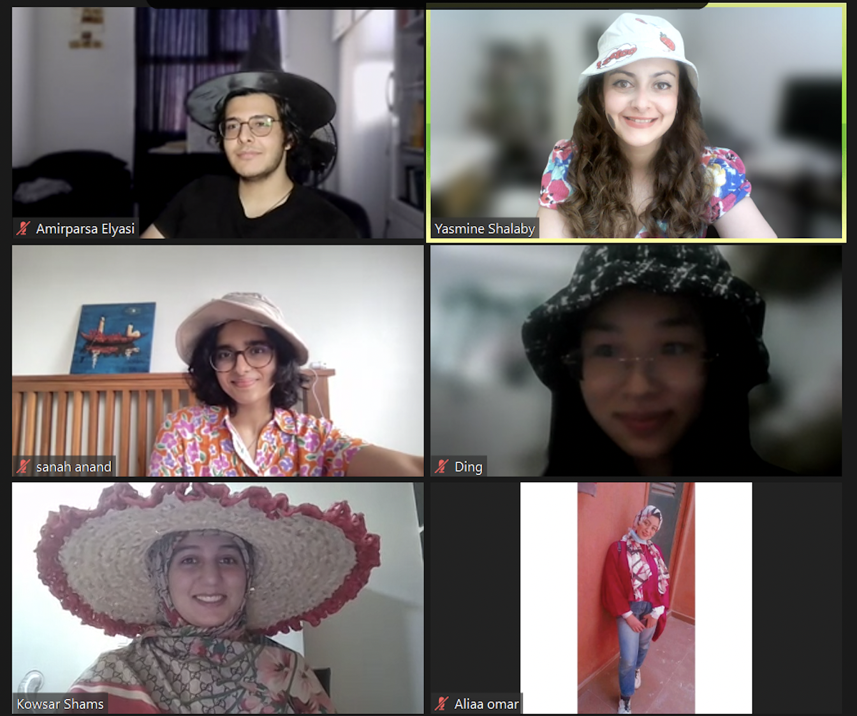
The
Team!
Amirparsa Elyasi
Yasmine Shalaby
Ding
Sanah Anand
Aliaa Omar
Kowsar Shams

Slide 3
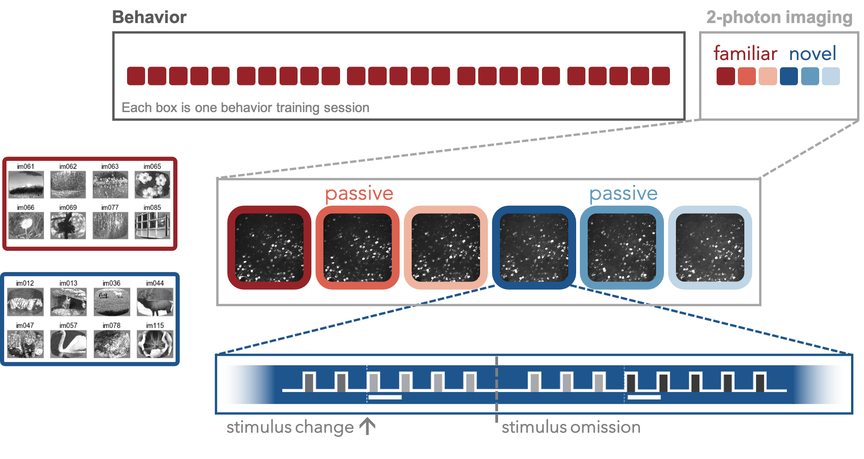
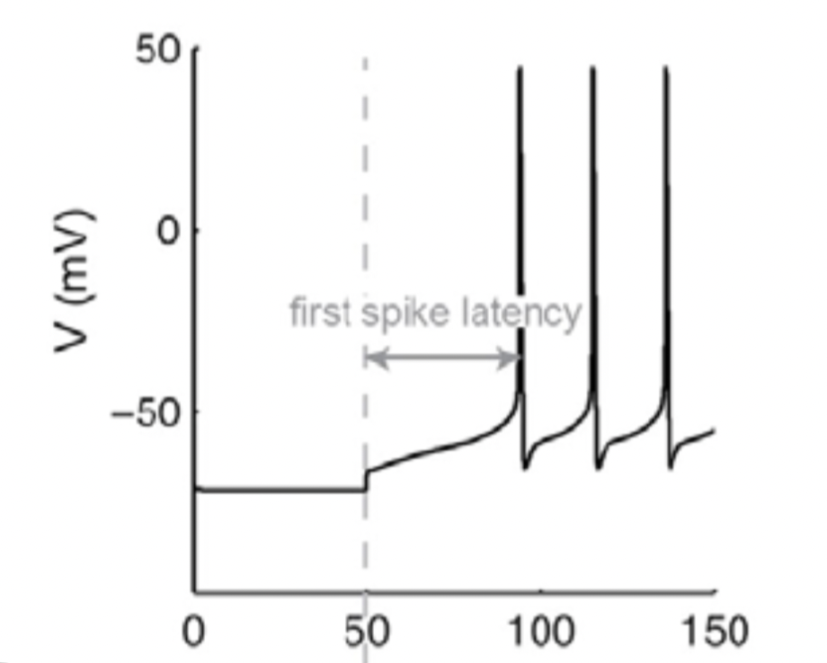
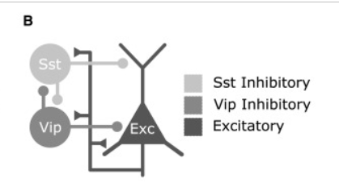
Background
2-photon Calcium imaging while images presented (lick → reward)
Familiar (trained) vs. Novel images
Expected vs. Unexpected (Omitted)
Excitatory vs. Inhibitory (SST/VIP)
Stimulus onset → latency = delay → Neural Response
Neuronal Latency: specific to type
Behavioural Latency: Licks + Pupil Size
Notes:
Ding

Slide 4
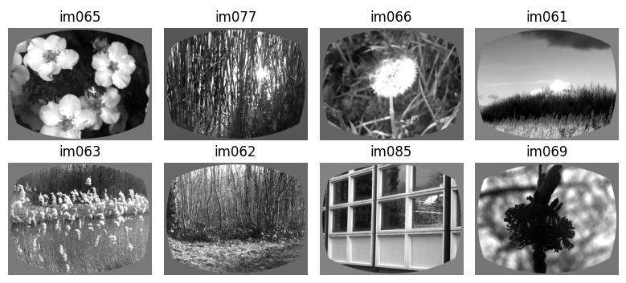
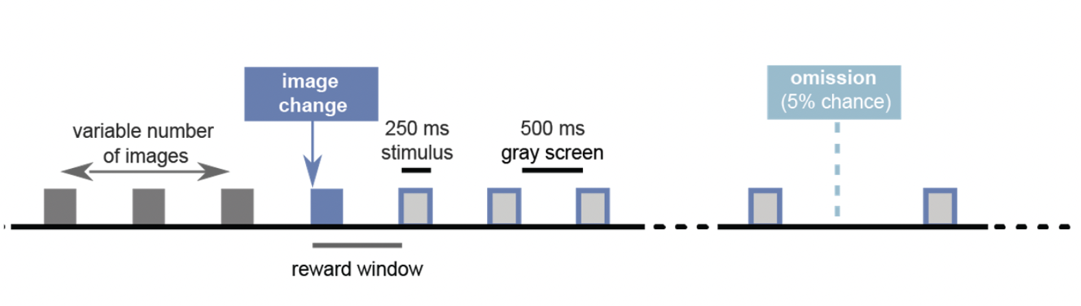
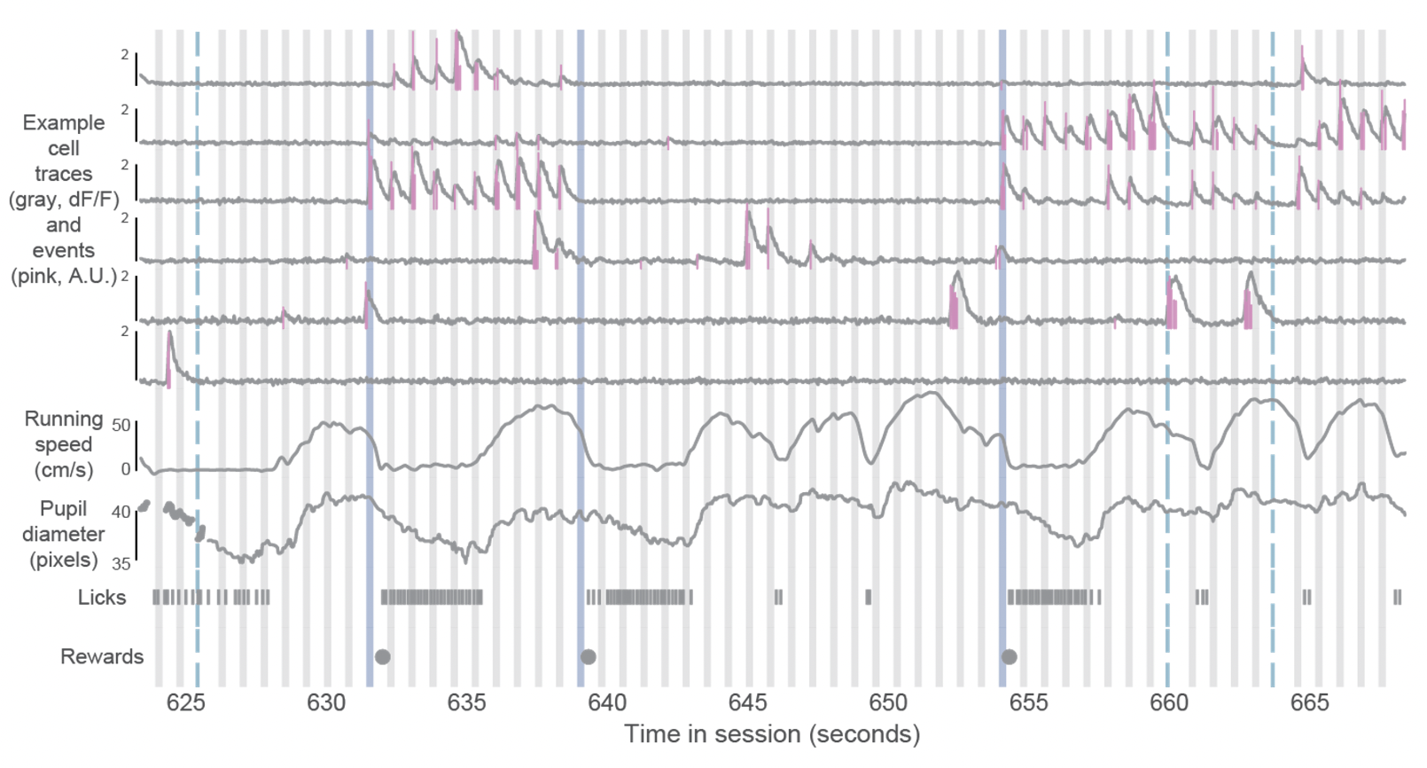
Notes:
Ding

Slide 5
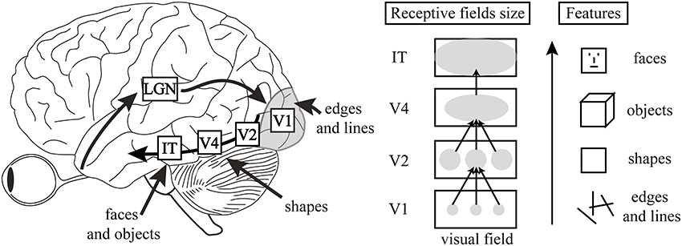
Visual System Hierarchy
Light enters the retina (Photoreceptors) → Projects to lateral geniculate nucleus → Projects to visual areas in the occipital cortex
Given the hierarchical nature, there is a latency between stimulus presentation and neuronal activation
Notes:
Sanah Anand

Slide 6
Investigative Questions
Response Latencies of VIP vs. SST Neurons:
How do the response times (latencies) of VIP and SST neurons differ when exposed to visual stimuli?
Effect of Stimulus Familiarity on Response Latencies:
How does the familiarity or novelty of a visual stimulus impact the response times of VIP and SST neurons?
Predicting Behavioral Responses from Neuronal Latencies:
Can we predict behaviors, such as licking actions or changes in pupil size, based on the response times of these neurons?
Notes:
Alia

Slide 7
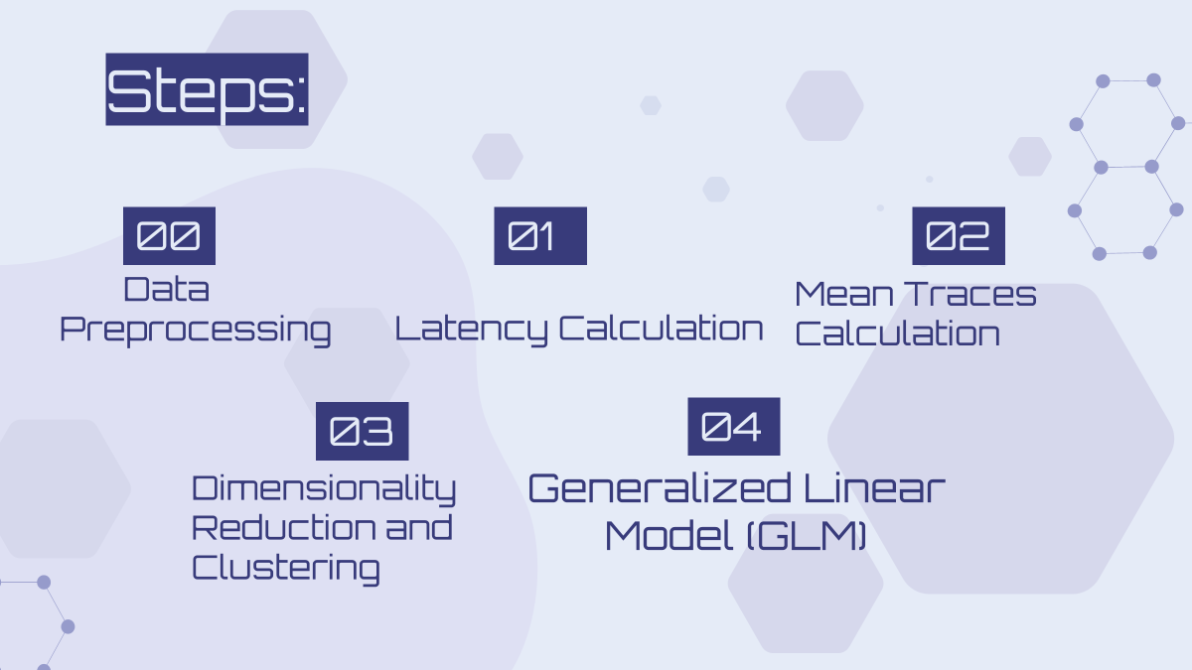
Methodology and Approach
Notes:
Alia
Edit: Training GLM should be added

Slide 8
Hypotheses
Difference in Latencies:
We expected to find differences in the response times of VIP and SST neurons because they encode stimulus features differently.
Impact of Familiarity & Novelty:
We hypothesize that the speed at which neurons respond will differ based on how familiar the stimulus is, with familiar stimuli leading to faster responses compared to novel stimuli.
Notes:
Alia

Slide 9
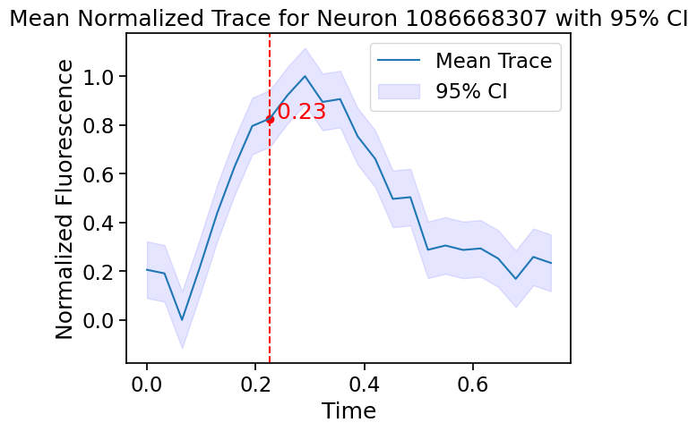
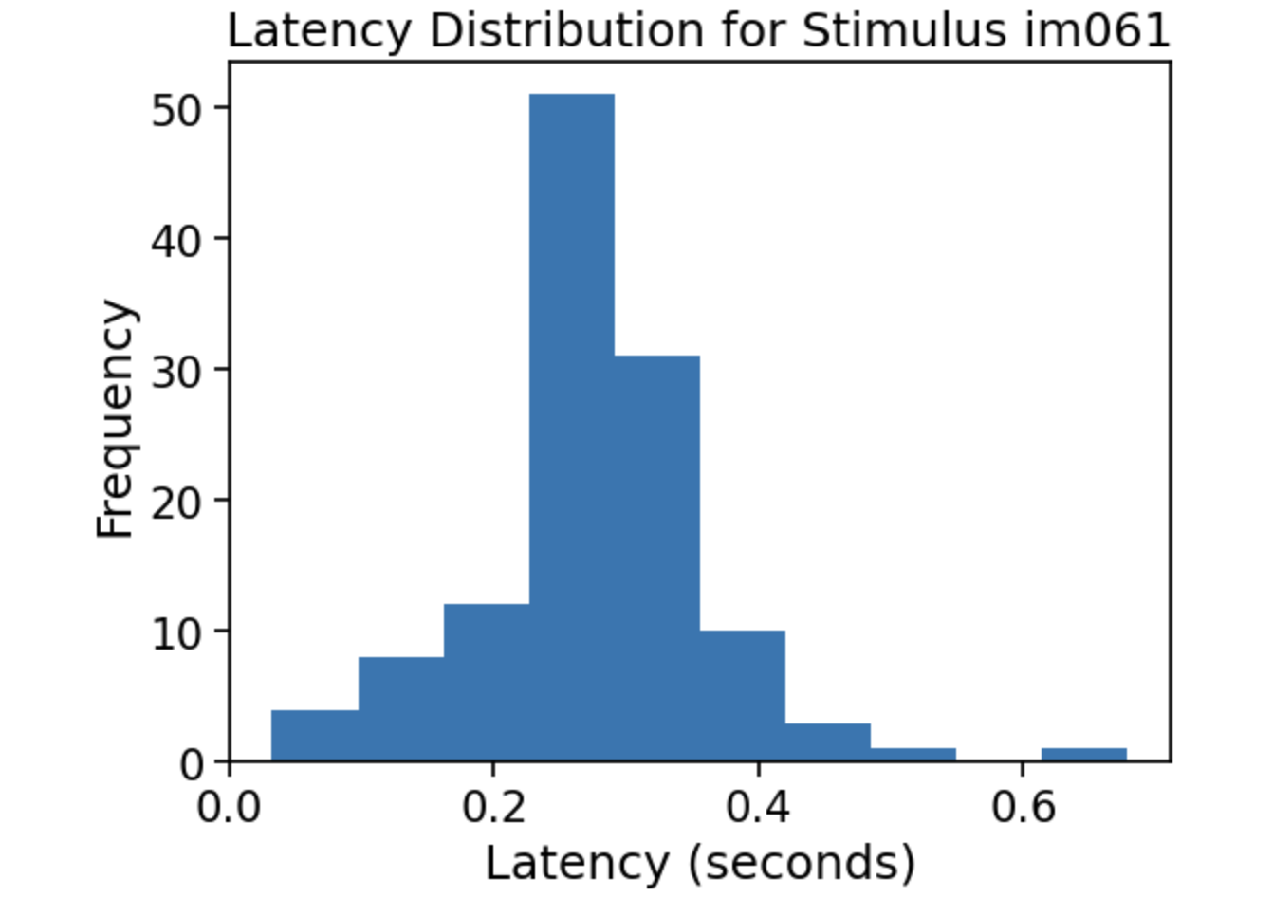
Visualizing Neuronal Latencies
Example Mean Trace of Fluorescence for an SST neuron (Latency Visualized):
Example Histogram of Latencies for Response to an Image Across Neurons:
Notes:
Kowsar

Slide 10
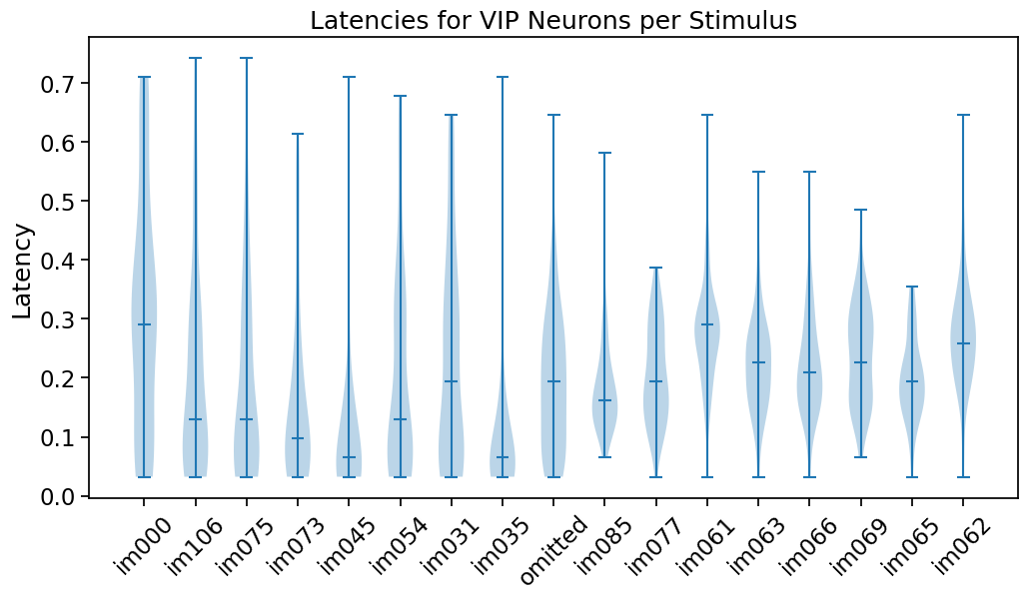
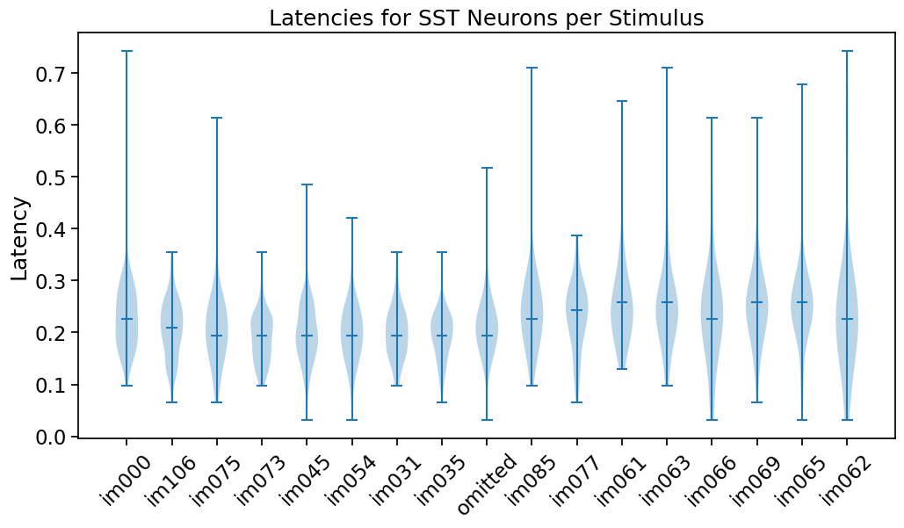
Comparing SST and VIP Neurons’ Latency For Different Stimulus
Notes:
Kowsar

Slide 11
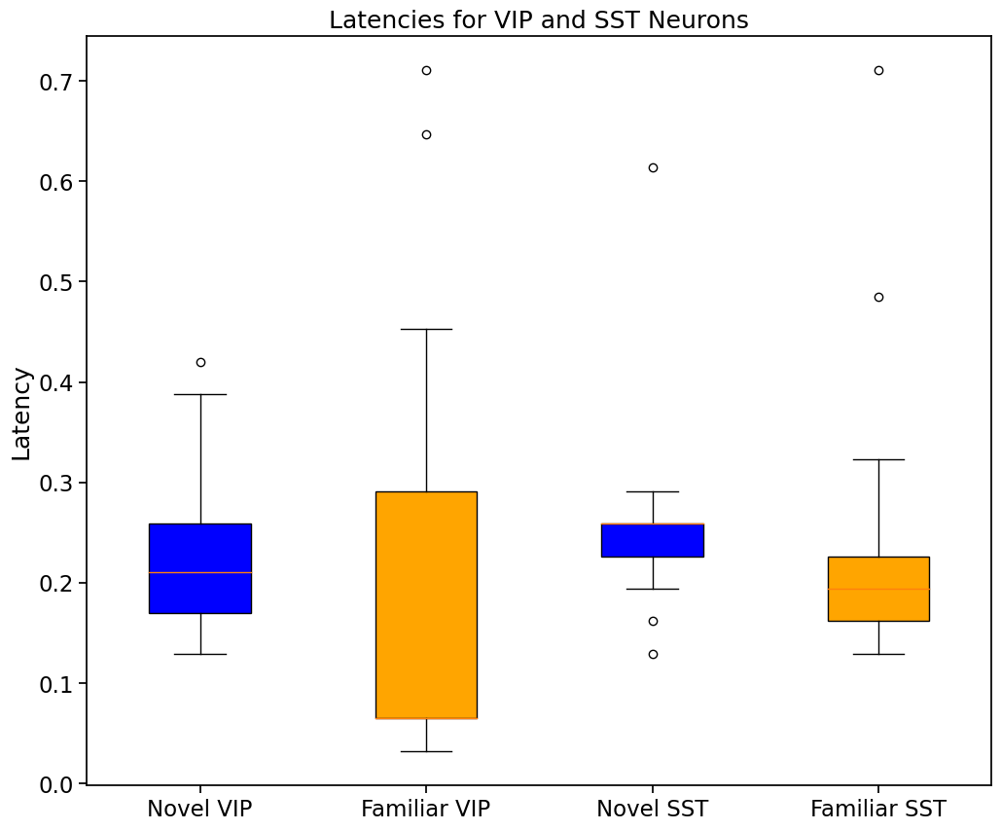
Comparing SST and VIP Neurons’ Latency For Familiar and Novel Stimulus
Notes:
Kowsar

Slide 12
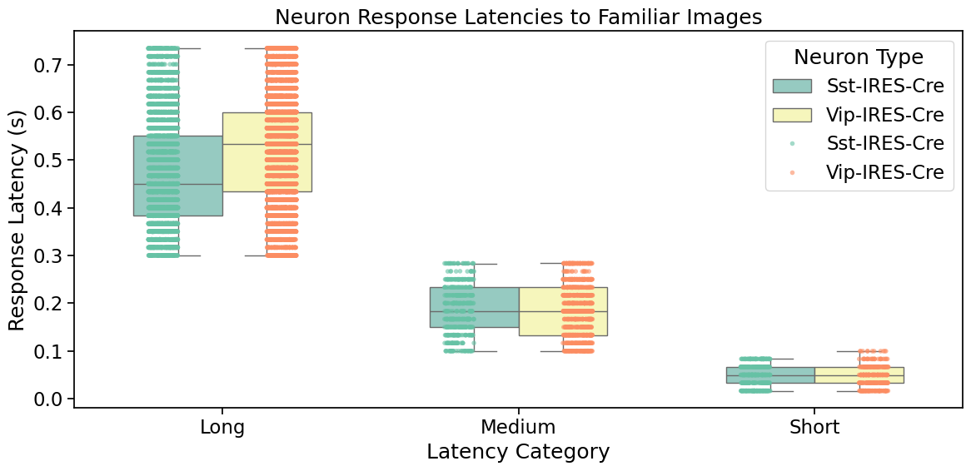
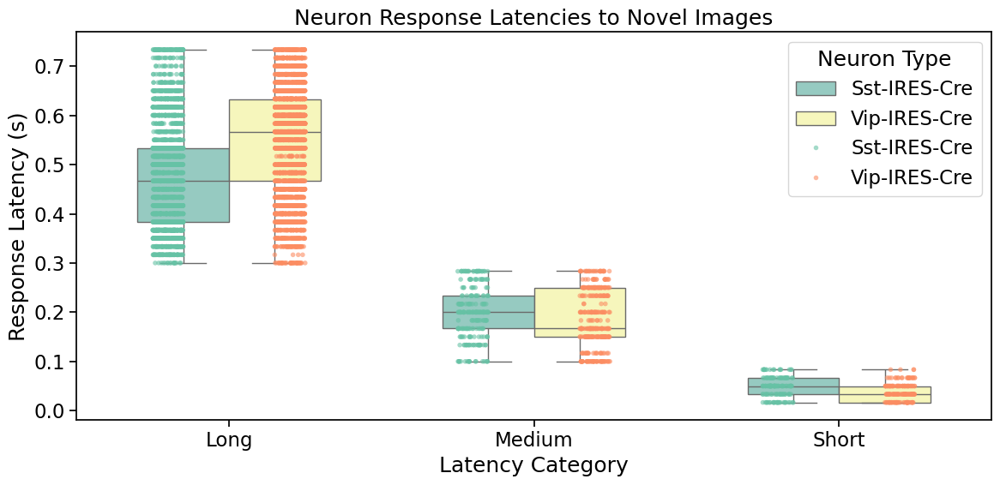
Neuronal Response Latencies in Response to Familiar/Novel Images
Categorized Latencies:
Short: < 100 ms
Medium : 100 - 300 ms
Long > 300 ms
On average SST neurons had shorter latencies for both Novel and Familiar image responses
Both neuronal types showed slightly longer latencies for novel images compared to familiar ones.
Notes:
Yasmine Shalaby

Slide 13
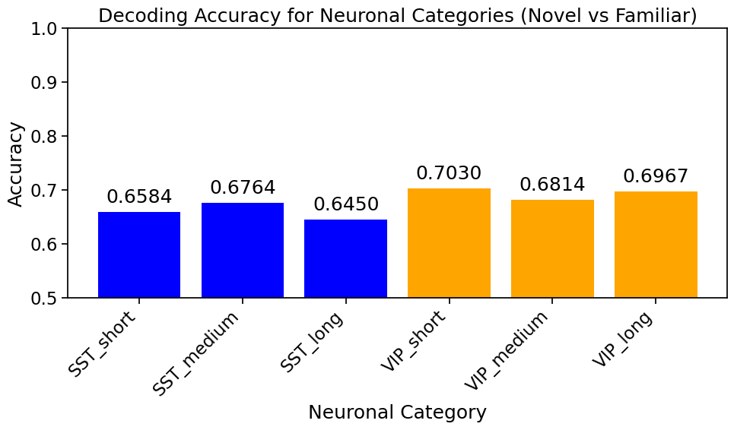
Decoding Neuronal Responses: SST vs VIP Neurons
Analysis of SST and VIP Neurons Based on Behavioral Data
Behavioral data (running speed and pupil area) can predict neuronal responses with moderate to good accuracy.
VIP neurons show higher prediction accuracies compared to SST neurons.
Prediction accuracy decreases with increasing latency.
Notes:
Yasmine Shalaby

Slide 14
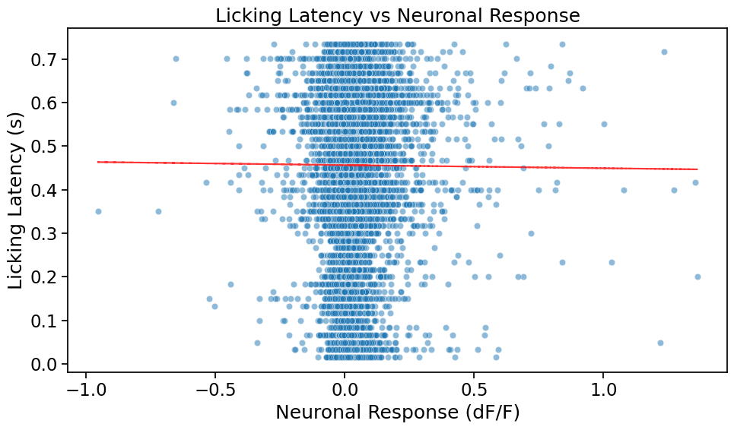
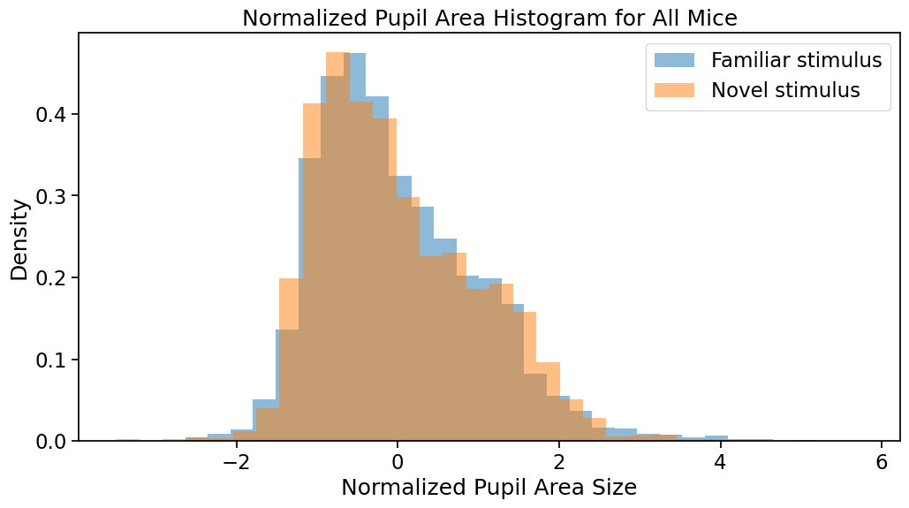
Correlation and Regression Analysis of Neuronal Response and Licking Latency
Visualizing Mice Pupil Area
No significant correlation found between neuronal response and licking latencies correlation coefficient of -0.0032 P-value: 0.6402
No significant distinguishing of familiar vs. novel stimuli on the basis of pupil area
Notes:
Yasmine and Amir

Slide 15
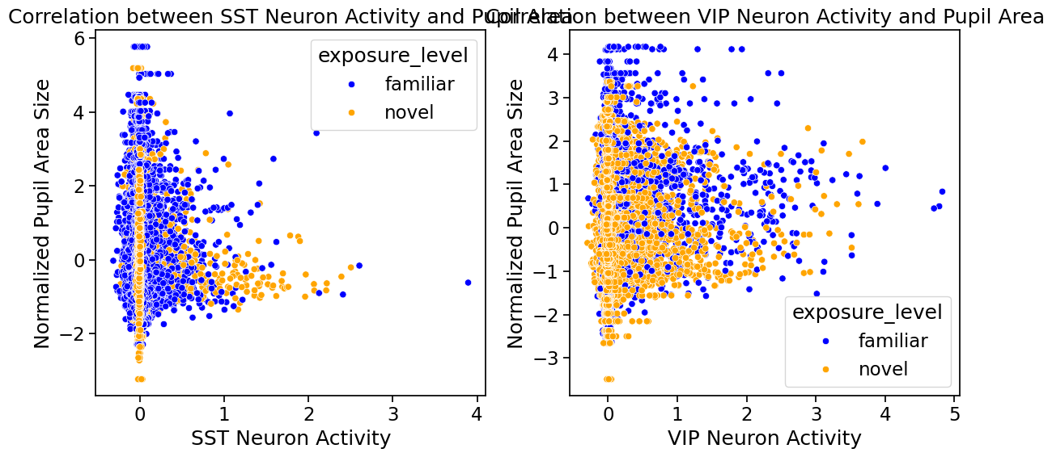
No significant distinguishing for VIP and SST neurons the basis of pupil area
Notes:
Amir

Slide 16
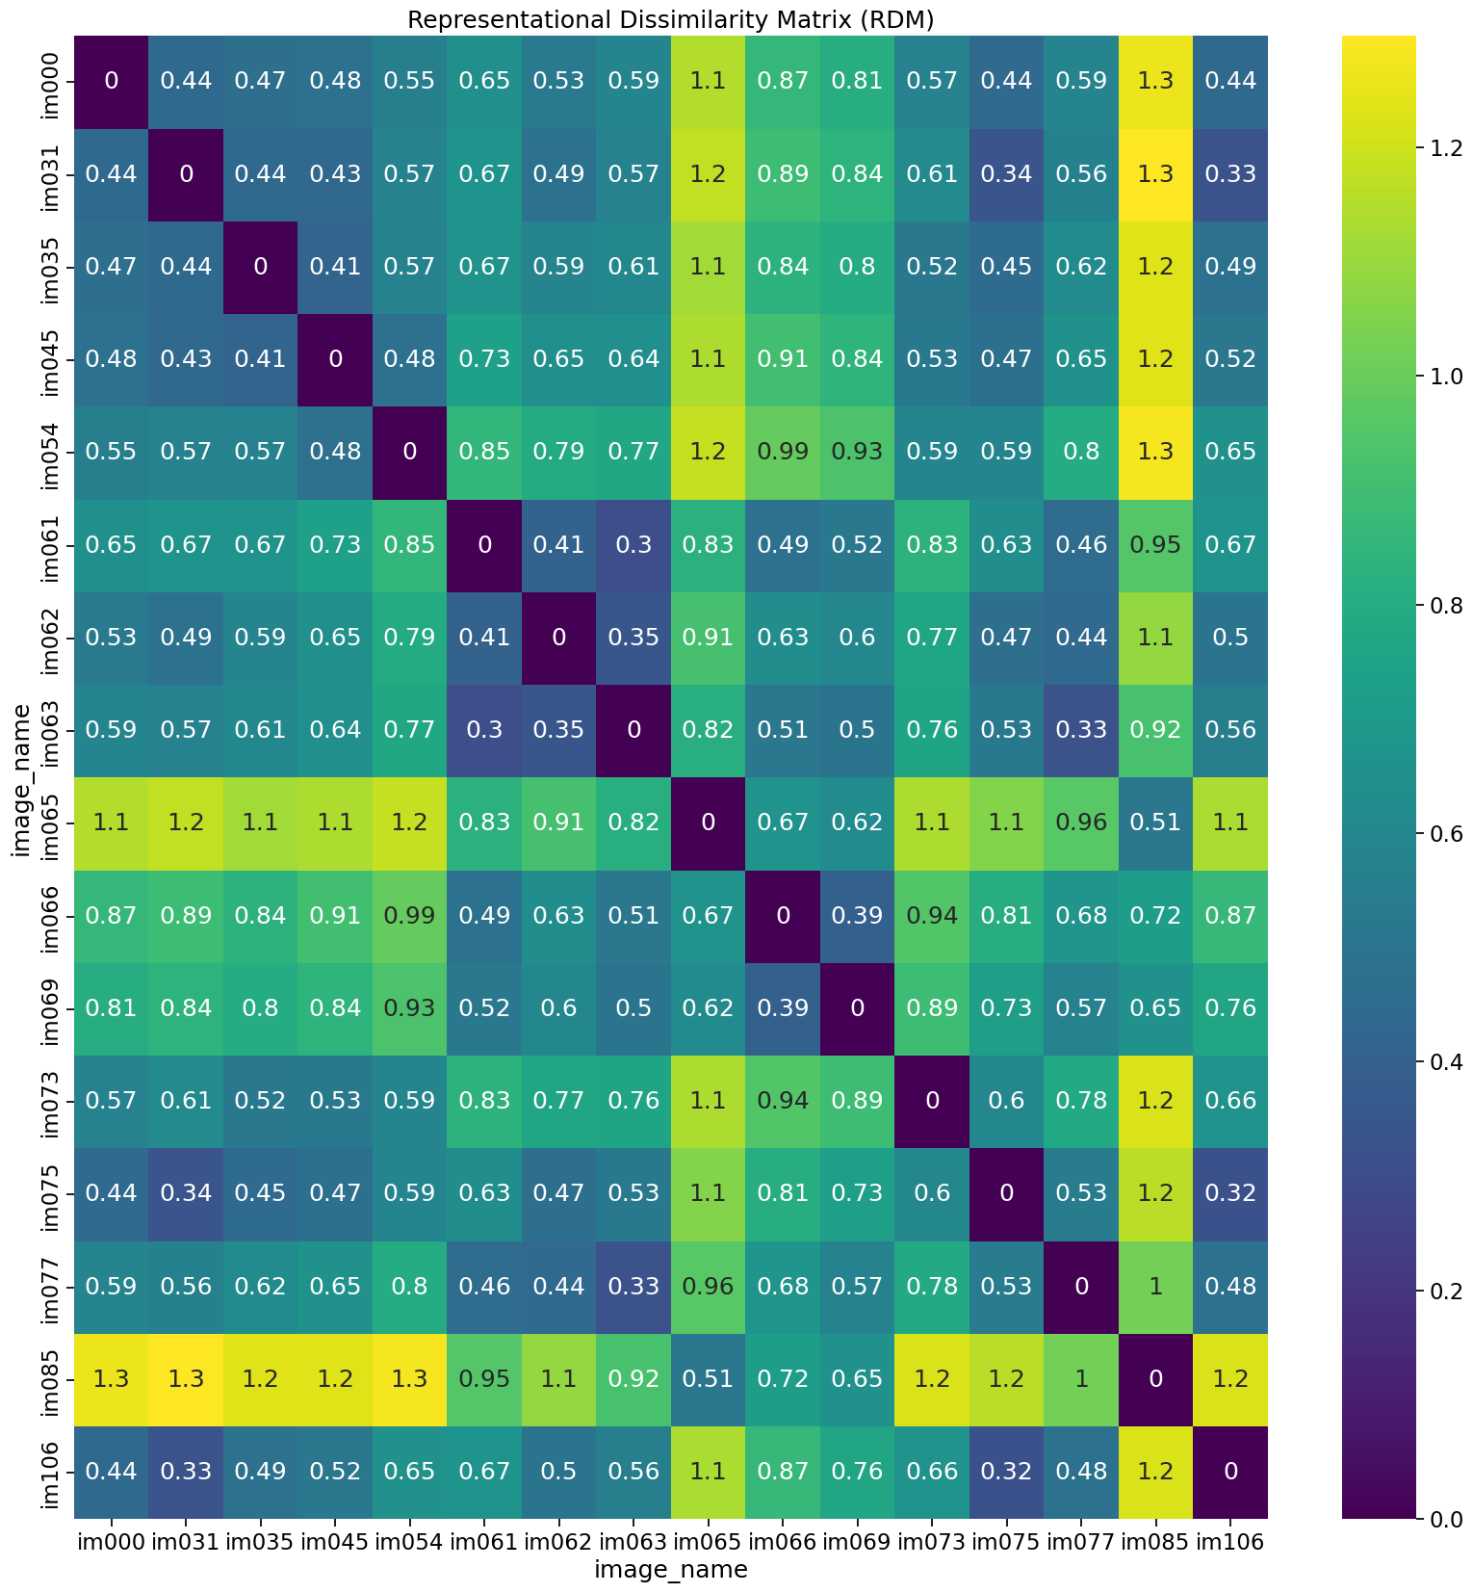
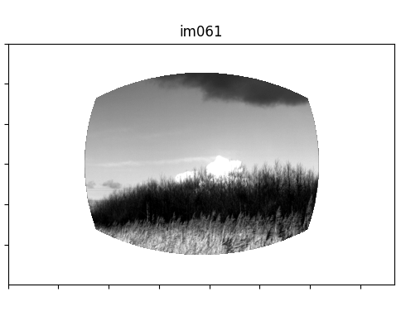
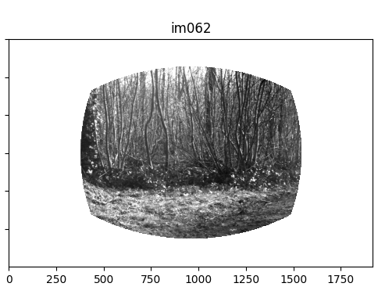
Investigating Neural Response to Different Stimulus
Notes:
Kowsar

Slide 17
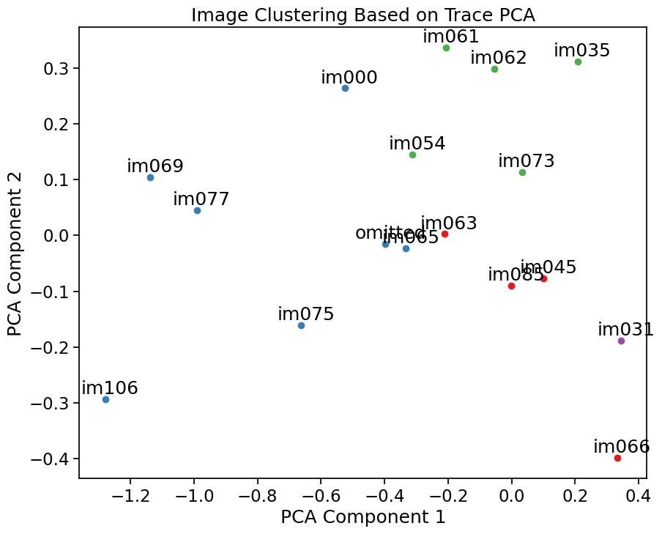
Investigating Neural Response to Different Stimulus
Notes:
Kowsar

Slide 18
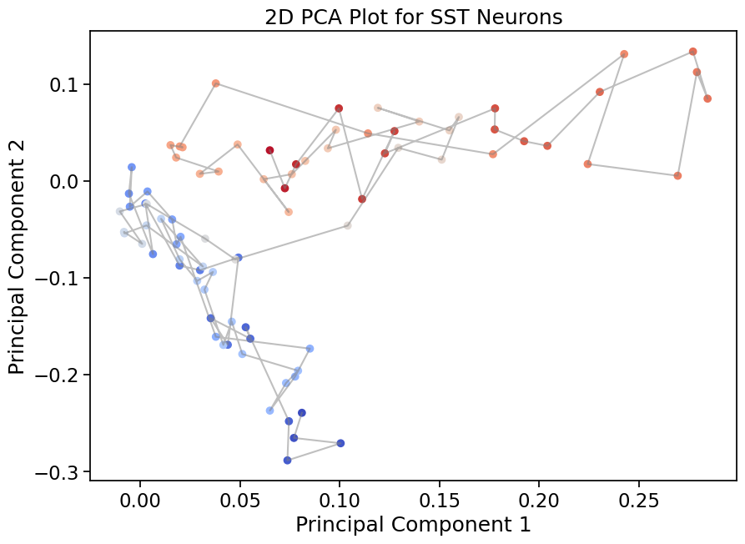
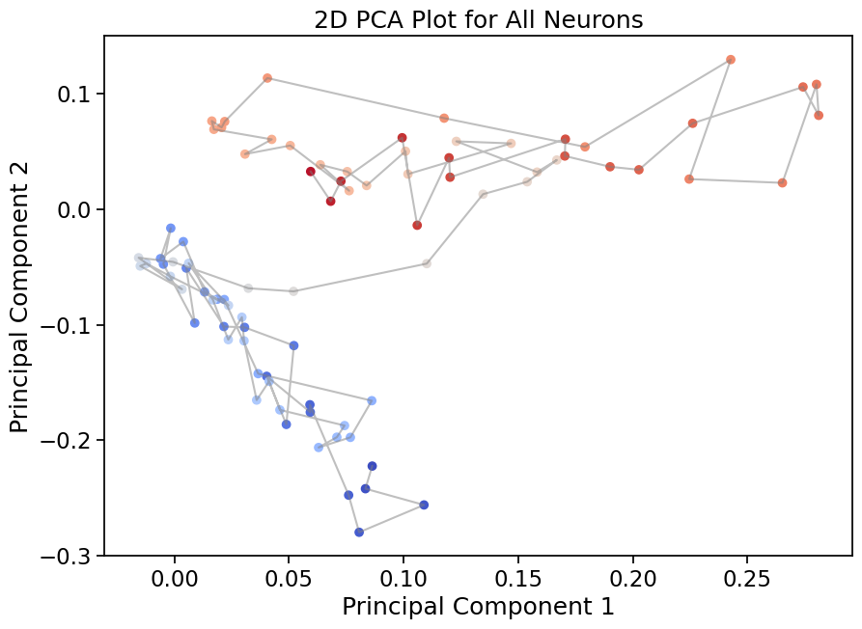
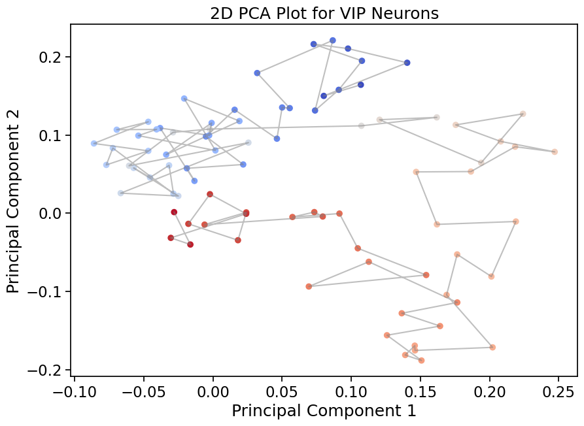
Comparing VIP and SST Neurons Traces

Slide 19
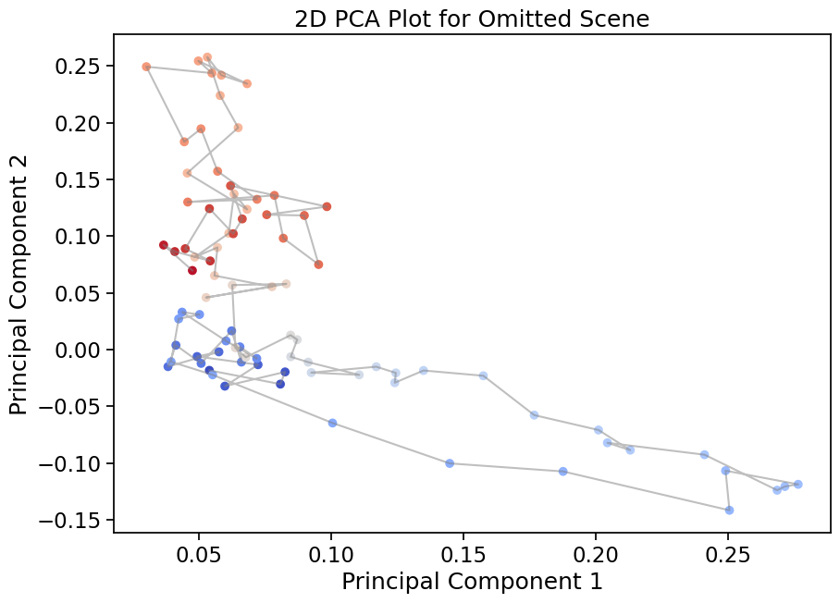
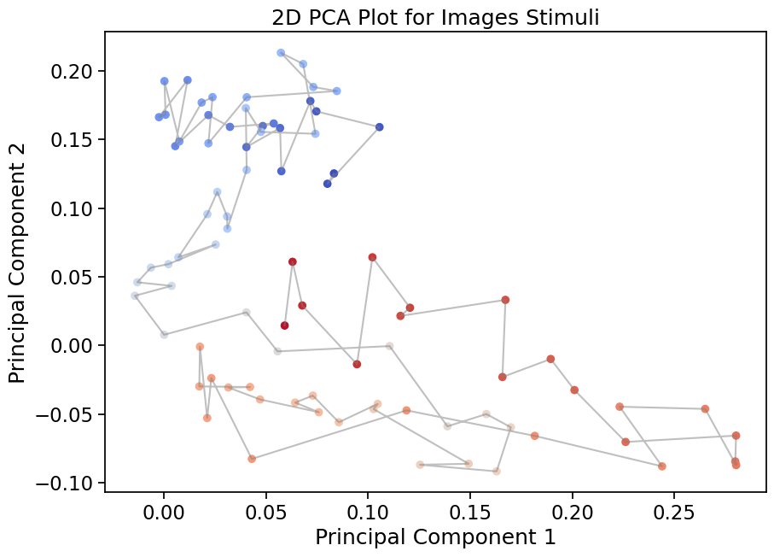
Comparing Neurons Traces for Different Stimulus

Slide 20
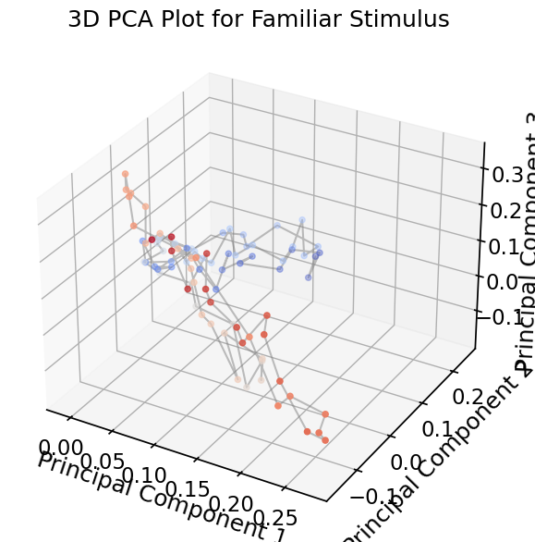
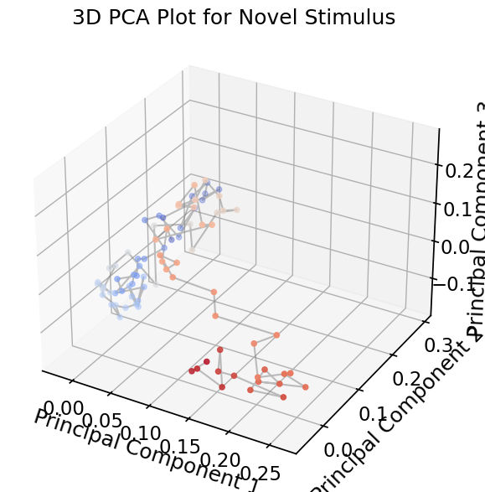
Comparing Familiar and Novel Stimulus Traces

Slide 21
Conclusion
Latencies characterized for SST/VIP neurons for familiar vs. novel images and clustered for images
Neuronal Latencies predicting Behavioural Latencies
Latencies (Behavioural vs. Neuronal): the delay between stimulus onset and [neural] response
Specific neurons encode and respond differently based on activation in receptive fields distinct latencies based on neuronal type
Future Exploration:
Linear → Nonlinear
Adding Excitatory input (recurrent circuitry)
Building a decoder that distinguishes image type based on stimulus feature clusters
Clustering based on Latencies: SST neurons had shorter latencies than VIP neurons on average
VIP neurons have greater accuracy in predicting behavioural latencies → decreases with greater latencies
Representational Dissimilarity Matrix showed some images show similar activations
Notes:
Sanah The wide range of latencies (from about 17 ms to 734 ms) suggests a diverse set of neuronal responses, which could be interesting to explore its features in the further

